Slide 1
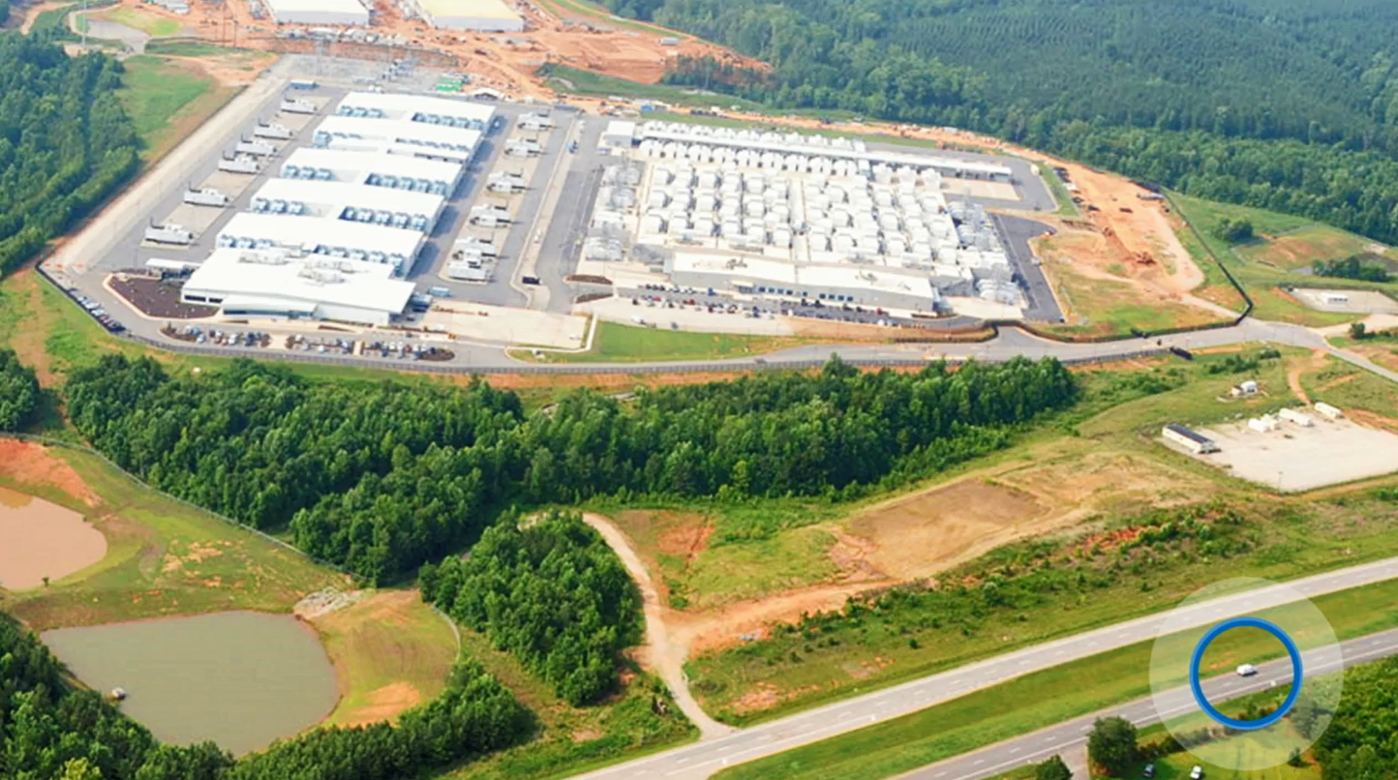
Microsoft Azure Workshop
David.Gristwood@microsoft.com
@ScroffTheBad

Slide 2
People
David.Gristwood@microsoft.com
Mark.Bloodworth@microsoft.com
Bianca Furtuna bifurt@microsoft.com
Jonathan Collinge jocollin@microsoft.com
Jamie.Dalton@microsoft.com
Steven.Jarvis@microsoft.com
Agenda
10:00 AM Workshop starts, with breaks for coffee, and lunch around 1pm
Data on Azure
Microservices and containerisation
DevOps
Design Considerations - Richard 'Tricky' Bassett tricky@trickybusiness.com
Partnering with Microsoft
2:15 PM Intelligence as an Embedded Service Masterclass
4:15 PM Informal networking and close

Slide 3
Microsoft Azure
The cloud platform
built for business and
innovation

Slide 4

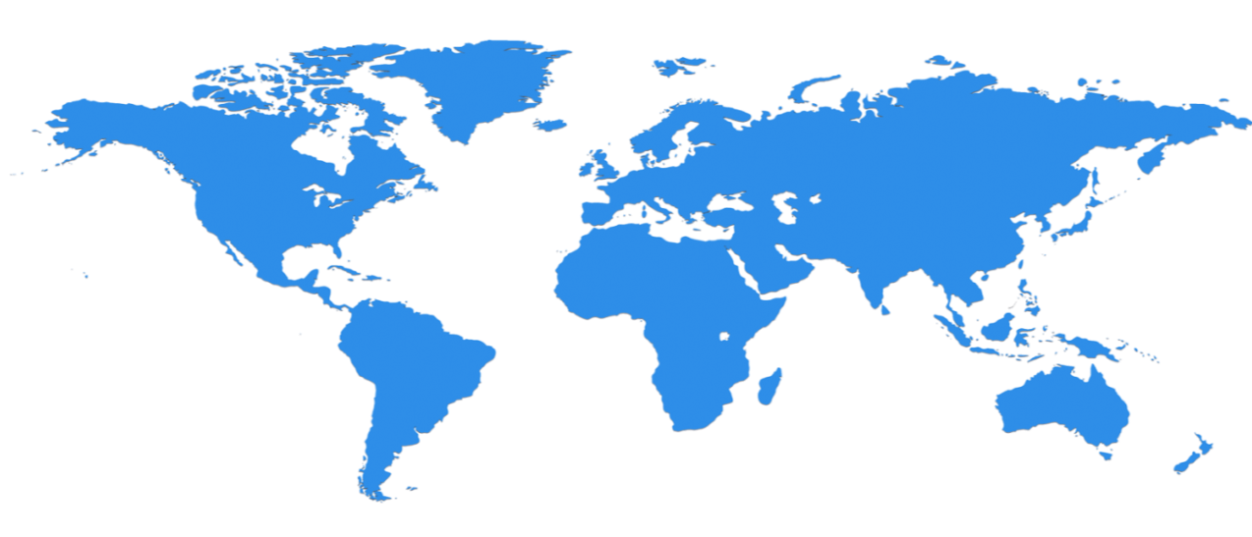

Huge infrastructure scale is the enabler
24 Regions Worldwide…huge capacity around the world…growing every year
UK
North Central US
Illinois
Germany
North Europe
Ireland
West Europe
Netherlands
Central US
Iowa
Canada Central
Toronto
Canada East
Quebec City
US Gov
Iowa
China North *
Beijing
China South *
Shanghai
Japan East
Saitama
West US
California
East US
Virginia
India Central
Pune
Japan West
Osaka
South Central US
Texas
East US 2
Virginia
US Gov
Virginia
India South
Chennai
India West
Mumbai
East Asia
Hong Kong
SE Asia
Singapore
Australia East
New South Wales
Brazil South
Sao Paulo
Australia South East
Victoria
100+ datacenters
Top 3 networks in the world
2x AWS, 6x Google DC Regions
G Series – Largest VM in World, 32 cores, 448GB Ram, SSD…
Operational
Announced/Not Operational
* Operated by 21Vianet

Slide 5
Azure StorSimple
Azure in Open
Azure Government
Azure SQL Database
Rights Management (RMS)
Azure API Management
Azure Site Recovery
Azure Automation
Instance Level Public Ips
Azure Redis Cache
Azure Batch
Azure Marketplace
Azure Data Factory
Stream Analytics
Event Hubs
Operational Insights
Premium Storage
Virtual Machine Converter 3.0
Cloud Platform System (CPS)
Antimalware for Cloud Services and VMs
Identity Manager vNext
Analytics Platform System (APS)
Visual Studio Community 2013
Visual studio 2015 Preview
.NET 2015
Azure RemoteApp
Azure AD Basic
SSD-based instances for Microsoft Azure VMs and Cloud Services
Azure SQL Database Auditing
Live Channels for Azure Media Services
AAD Application Proxy
New experiences in Power BI
Azure DocumentDB
Azure Search
HDInsight for Storm Public Preview & GA
Azure Zone Redundant Storage
HDInsight for Hbase
WSSC vNext tech preview
Content Protection pub preview
Intune - Nov update and Dec update
Azure AAD premium features
Multi-Factor Auth enhancements
Cloudera and Hortonworks on clustered Azure VMs
Azure Instance level IP
Azure Role Based Access Controls
VPN support pub preview
TiP Testing pub preview
Azure AD Workday A148 Integration
Azure Standard SSG
ExpressRoute S2S, P2S GA
Azure Multiple NICs
Azure Networking Appliances
Azure Traffic Manager Nested policies
Azure VM Image Gallery expansion
Azure Vnet
Azure Web Jobs
VSO datacenter expansion
VSO REST Hooks pub preview
Australia datacenter
Forced Tunneling
WSSC Azure Packs
Azure G-Serves Instances
Azure Key Vault
Drivers for SQL Server
MDM for Office 365 public preview and GA
Azure Media Services Content Protection
Azure Mobile Engagement
Node.js Tools for Visual Studio
Visual Studio 2013 updates
Auto-HA for SQL Server VM
Auto-Patching and Backup for SQL Server VMs
Azure SQL Database Increased Compatibility
Azure AD Connect Health pub preview
Azure AD MFA Per App / Conditional access pub preview
Azure RMS controlled user deployment
Azure RMS departmental templates pub preview
Azure Site Recovery SAN Replication
ASP.NET 5 Preview
Azure SDK 2.5.1
Team Foundation Server 2015 preview
Azure Machine Learning GA
Azure HDInsight for Linux Pub Preview
Azure HDInsight Support for Hadoop 2.6 pub preview
Azure SQL Database security feature - Data Masking pub preview
Azure SQL Database security features - Encryption
Azure SQL Database security features - Row Level security
Azure AD: API for SIEM
Microsoft Intune monthly updates
Remote Desktop Client for Windows Phone 8.1
Azure App Service
Azure CDN Integration
Azure Media Encoder Premium
Azure AD Premium & Basic in CSP
Azure IoT Suite
Windows Server Containers
Hyper-V Containers
Windows Server Nano Server
Azure Media Player GA
Azure Service Fabric
Azure IoT Suite
Azure Site Recovery: Protect VMWare and Physical Servers in Public Preview
Azure Backup Generally Available
Azure API Management Premium simplifies high availability and massive scale for APIs
ExpressRoute for Office 365
Azure Active Directory Dynamic Membership For Groups
Automatic Password Change for Social Media Shared Accounts
Compute-Intensive A10 and A11 Virtual Machine Instances
Remote Desktop app for Windows Phone support for Gateway and Remote Resources
Informatica Cloud Agent availability in Linux and Windows Virtual Machines
Azure DocumentDB Hadoop Connector
Azure HDInsight support for more VM sizes
Enterprise-Grade Array-Based Replication and Disaster Recovery with ASR and System Center GA
500+
New releases in
the last 12 months
Notes:
112

Slide 6














































Azure is an open cloud
DevOps
Clients
Management
Applications
PaaS &
DevOps
App Frameworks
& Tools
Databases &
Middleware
Infrastructure
Notes:
P2

Slide 7




















































Platform Services
Security & Management
Compute
Web and Mobile
Developer Services
Hybrid
Operations
Cloud
Services
Service
Fabric
Web Apps
API
Apps
API
Management
Visual Studio
Azure SDK
Portal
Azure AD
Connect Health
Batch
Remote App
Mobile
Apps
Logic
Apps
Notification
Hubs
Team Project
Application
Insights
Active
Directory
AD Privileged
Identity
Management
Multi-Factor
Authentication
Integration
Analytics & IoT
Data
Backup
Storage
Queues
Biztalk
Services
Automation
HDInsight
Machine
Learning
SQL
Database
SQL Data
Warehouse
Operational
Insights
Hybrid
Connections
Service
Bus
Key Vault
Data
Factory
IoT and Event
Hubs
Redis
Cache
Search
Import/Export
Store /
Marketplace
Media & CDN
Site
Recovery
Stream
Analytics
Mobile
Engagement
DocumentDB
Tables
VM Image Gallery
& VM Depot
Media
Services
Content Delivery
Network (CDN)
StorSimple
Infrastructure Services
Compute
Storage
Networking
Virtual Machines
Containers
BLOB Storage
Azure Files
Premium Storage
Virtual Network
Load Balancer
DNS
Express
Route
Traffic Manager
VPN Gateway
Application Gateway
Datacenter Infrastructure (24 Regions, 19 Online)

Slide 8
IOT & DATA INNOVATION PROGRAM
Jul – Sep 2016
WHAT IS IT?
Microsoft is partnering with communities to launch a new round Internet of Things & Data Innovation Programme to support up to 5 startups to accelerate bringing products and services to market through free technology, tools, training, go to market advisory & networking opportunities:
Up to $120k free Azure cloud services for 1 year (via BizSpark Plus)
Microsoft Tech Advisory to support development
Networking & Pitch Advisory with Microsoft Ventures Accelerator
Free technology and tools incl Azure, Visual Studio, Office365, Windows 10
Go To Market advisory & Networking opportunities with Microsoft partners and customers.
Deadline 30th June
for applications

Slide 9

SQL Database

